Slide 1

Principles of Web Design 6th Edition
Chapter 9 – Site Navigation

Slide 2
Objectives
Create usable navigation
Design navigation for mobile devices
Use graphics for navigation and linking
Build text-based navigation
Use lists for navigation
Build horizontal navigation bars
Build vertical navigation bars
Use background color and graphics to enhance navigation
Create hover rollovers

Slide 3
Creating Usable Navigation

Slide 4
Planning Site Navigation
Don’t skimp on navigation cues
Most modern web sites use primarily text-based graphics
If you choose to use graphics keep them simple and reuse them consistently

Slide 5
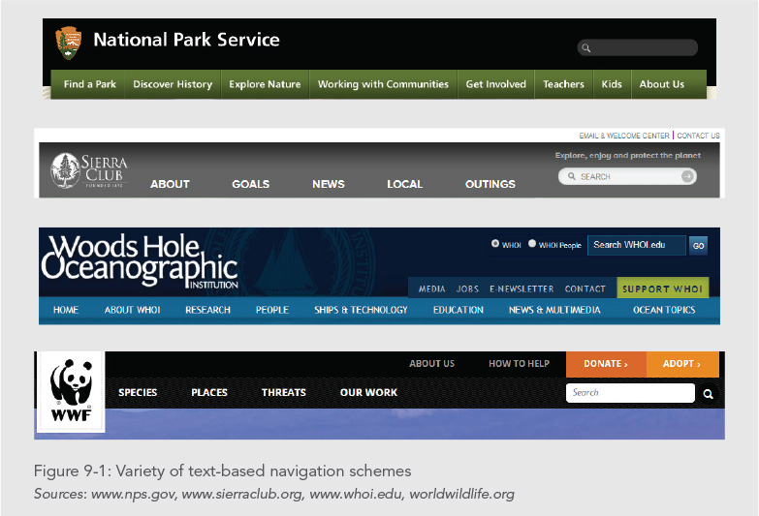

Slide 6
Orienting the User
Provide enough location information to let the user answer the following navigation questions:
Where am I?
Where can I go?
How do I get there?
How do I get back to where I started?

Slide 7
Orienting the User
To answer these questions, provide the following information:
Let users know what page they are on and what type of content they are viewing
Let users know where they are in relation to the rest of the site

Slide 8
Orienting the User
Provide consistent, easy-to-understand links
Provide an alternative to the browser’s Back button that lets users return to their starting point

Slide 9
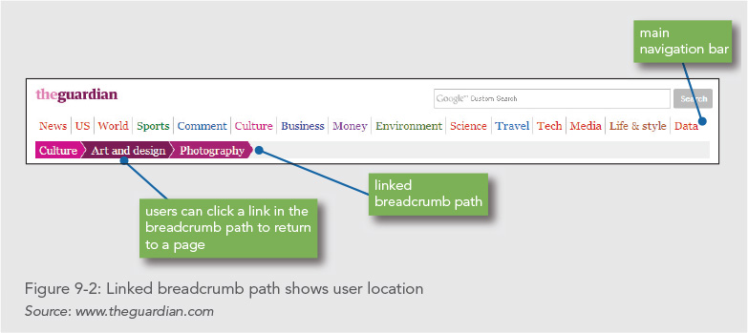

Slide 10
Limiting Information Overload
Create manageable information segments
Control page length
User hypertext to connect facts, relationships and concepts

Slide 11
Designing Navigation for Mobile Devices

Slide 12
Designing Navigation for Mobile Devices
Limiting information overload is especially important for mobile web sites
Minimize the number of clicks or taps
Use universal navigation symbols
Simplify the user’s choices

Slide 13
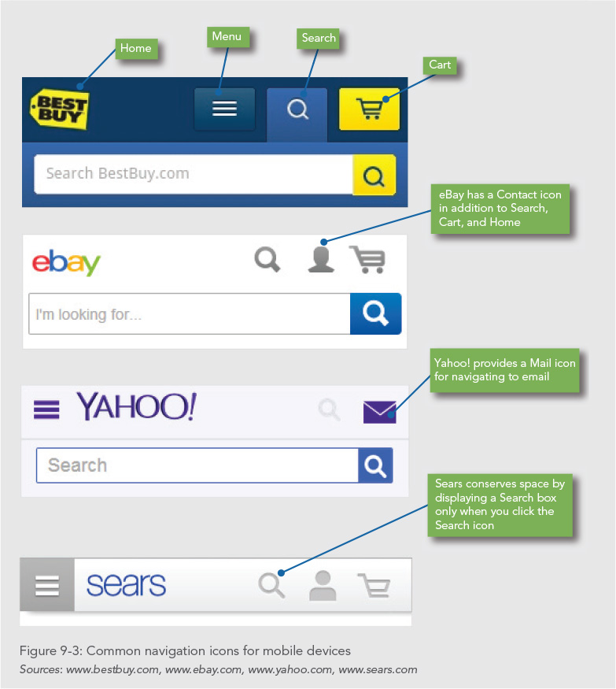

Slide 14
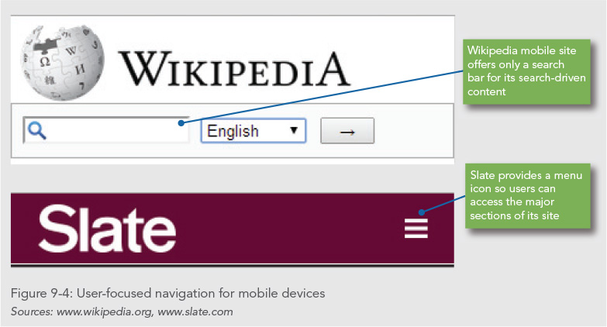

Slide 15
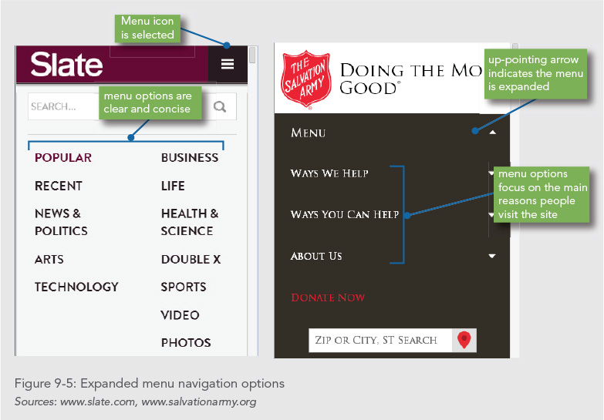

Slide 16
Using Graphics for Navigation and Linking

Slide 17
Using Graphics for Navigation and Linking
If you use graphics for navigation, use the same graphics consistently throughout your site
These provide predictable navigation cues for the user
Reusing graphics minimizes download time

Slide 18
Using the alt Attribute
Provide alternate text-based links in addition to graphical links
Include alt attributes in your <img> tags
The alt attribute is important to accessibility

Slide 19
Building Text-Based Navigation
Text-based linking is often the most effective way to provide navigation on your site
Always provide a text-based set of links as an alternate means of navigation

Slide 20
Adding Contextual Linking
Contextual links allow users to jump to related ideas or cross-references by clicking the word or item that interests them
These are links that you can embed directly in the flow of your content by choosing the key terms and concepts you anticipate your users will want to follow

Slide 21
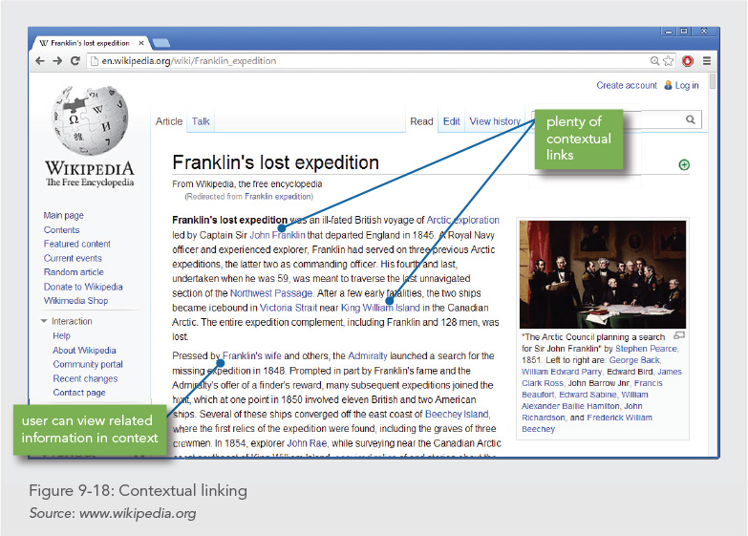

Slide 22
Using Lists for Navigation

Slide 23
Using Lists for Navigation
The HTML list elements are the preferred element for containing navigation links
Lists provide an easy way to create navigation that can be styled with CSS
<ul id="navlist">
<li><a href="index.html">Home</a></li>
<li><a href="history.html">History</a></li>
<li><a href="how.html">How it Works</a></li>
<li><a href="clubs.html">Balloon Clubs</a></li>
<li><a href="festivals.html">Festivals</a></li>
<li><a href="rides.html">Where to Ride</a></li>
<li><a href="faq.html">FAQ</a></li>
</ul>

Slide 24
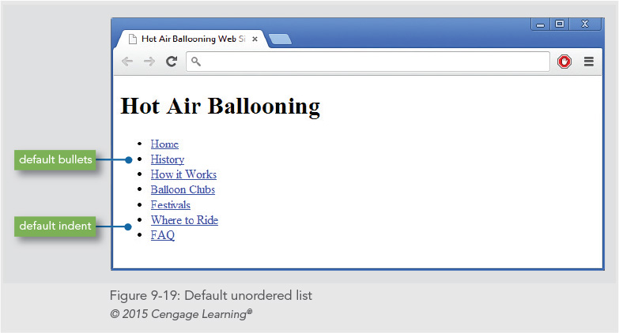

Slide 25
Removing Default Padding and Margin
Most lists have built-in padding or margin values
When creating navigation lists, you will need to remove this default spacing
Set the margin padding properties to zero for the UL element as shown
ul#navlist {
padding: 0;
margin: 0;
}

Slide 26
Removing Default Bullets
HTML lists come with built-in bullets
When creating lists for navigation, you can remove the default bullets
Use the list-style-type property as shown
ul#navlist {
padding-left: 0;
margin-left: 0;
list-style-type: none;
}

Slide 27
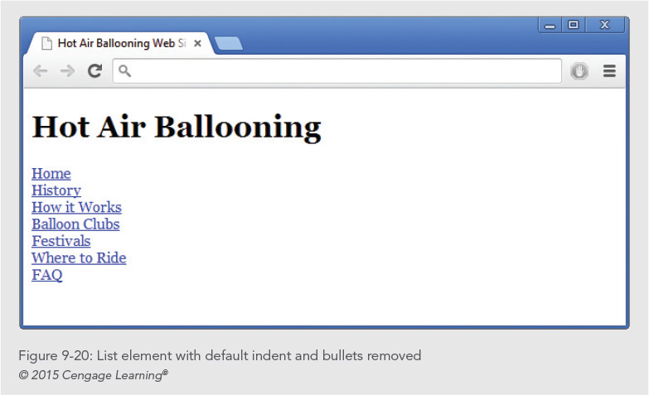

Slide 28
Building Horizontal Navigation Bars

Slide 29
Horizontal Navigation Bars
In a standard list, each item is on its own line
To create a horizontal navigation bar using the list, you need to set the list item display setting to in-line
This allows the list to display on one line
ul#navlist li{
display: inline;
}

Slide 30
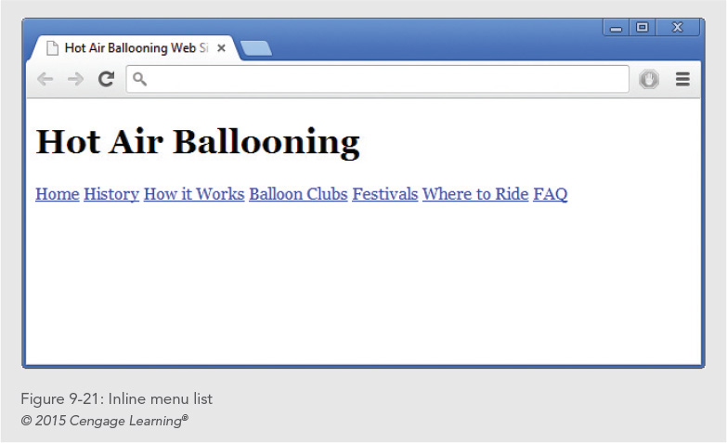

Slide 31
Customizing the Horizontal Navigation Bar
You can customize the basic list navigation with CSS properties
For example, you can:
Add borders, background colors, or images
Set space between buttons

Slide 32
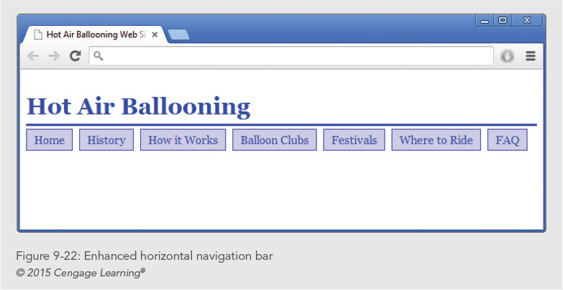

Slide 33
Controlling Navigation Bar Width
Horizontal navigation bars will wrap with the browser
To prevent this, set a width for your navigation list
ul#navlist {
padding: 0;
margin: 10px 0px 0px 0px;
list-style-type: none;
width: 700px;
}

Slide 34
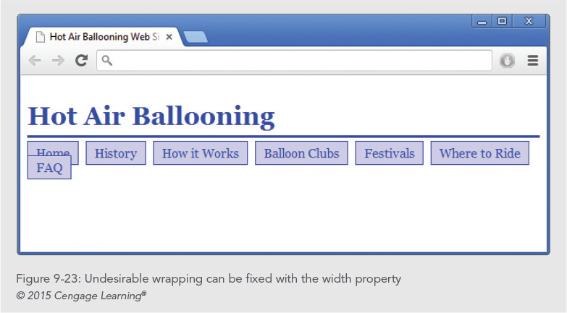

Slide 35
Controlling Navigation Button Width
To create navigation buttons that are all the same width, change the display type to block
Float the boxes so they align next to each other

Slide 36
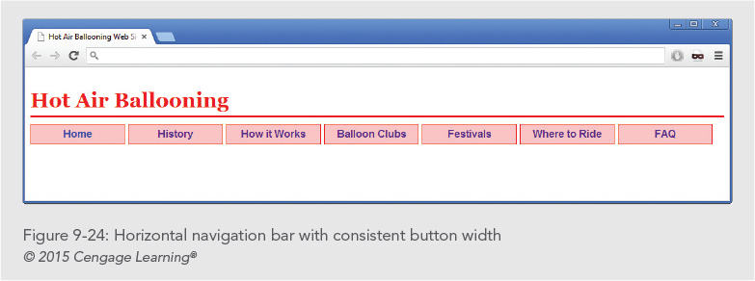

Slide 37
Building Vertical Navigation Bars

Slide 38
Building Vertical Navigation Bars
Use a standard list structure without changing the display type as you did for a horizontal navigation bar
The <a> elements in the list must be set to a block display property value

Slide 39
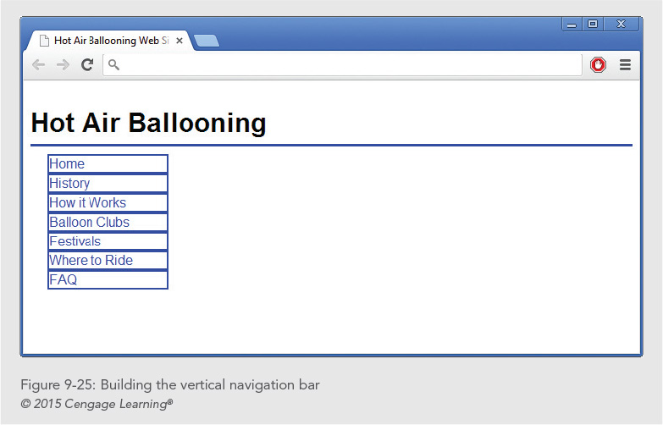

Slide 40
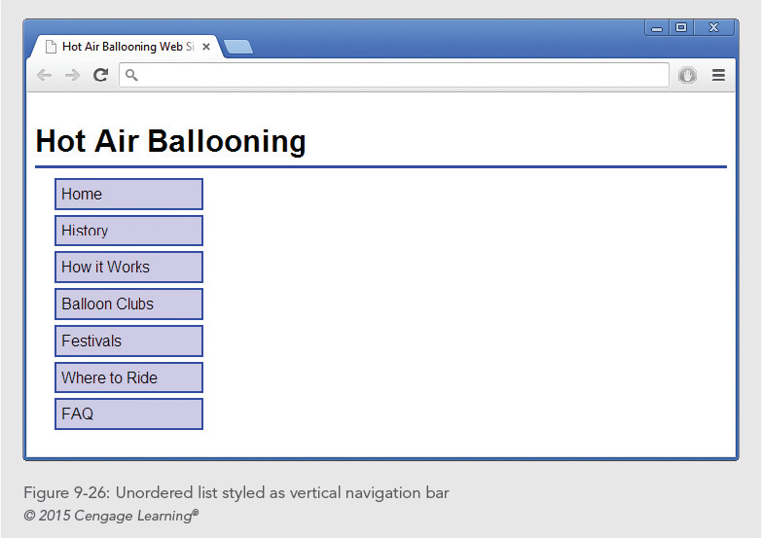

Slide 41
Using Background Color and Graphics To Enhance Navigation

Slide 42
Using Background Color and Graphics To Enhance Navigation
You can use background colors and graphics in a variety of ways to enhance your navigation
You can indicate location with graphic or background color
You can create interactive hovers that change when the user points to a link

Slide 43
Indicating History
Use the link pseudo-classes to show users where they have been
You can display a graphic based on the state of the link
In this example, the visited state causes a graphic check mark to display

Slide 44
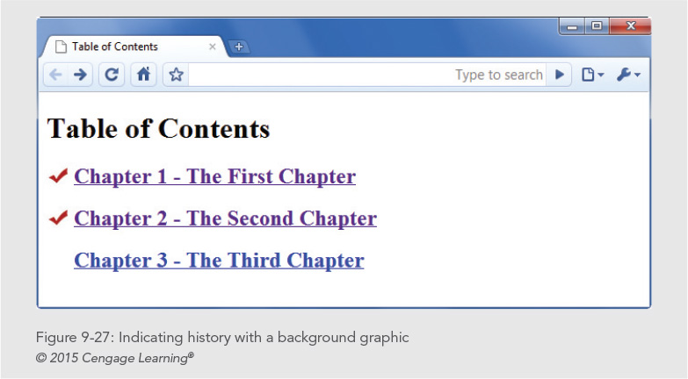

Slide 45
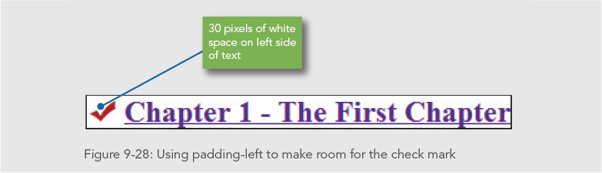

Slide 46
Indicating Location
Location can be indicated by a change in text weight, text color, or background color or with a graphic

Slide 47
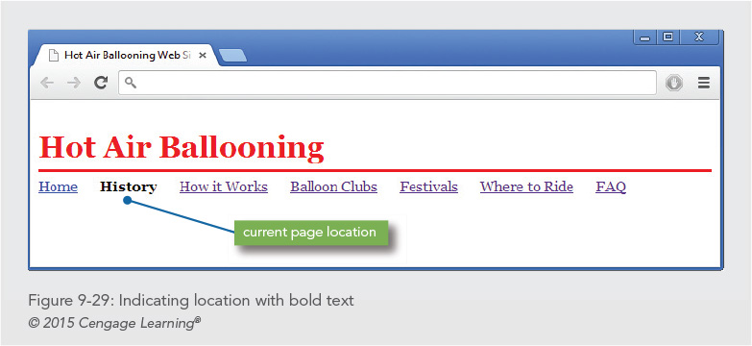

Slide 48
Creating Hover Rollovers

Slide 49
Changing Text Color and Background Color on Hover
The :hover pseudo-class lets you add interactivity when users scroll over your navigation links
In this example, when the user hovers the mouse over the link:
The text color changes to white (#fff)
The background color changes to bright blue (#0033cc)

Slide 50
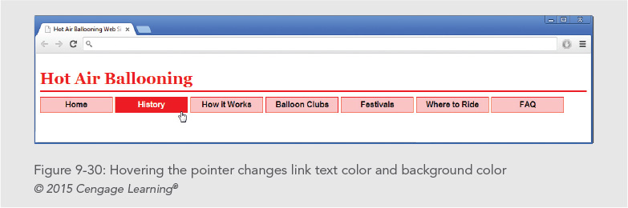
Changing Text Color and Background Color on Hover
ul#navlist a:hover {
color: #fff;
background-color: #0033cc;
font-weight: bold;
}

Slide 51
Changing Background Images on Hover
When the user hovers the pointer over a navigation button, the button color changes

Slide 52
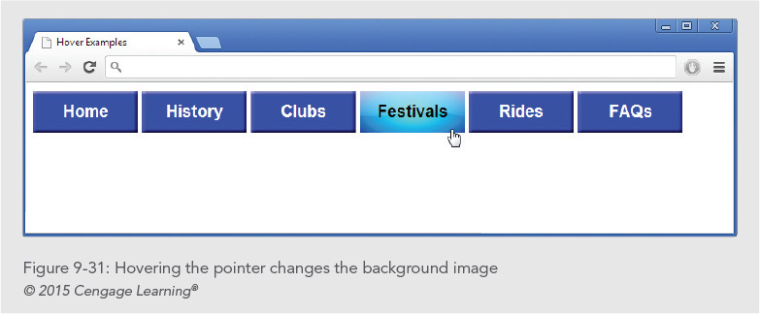
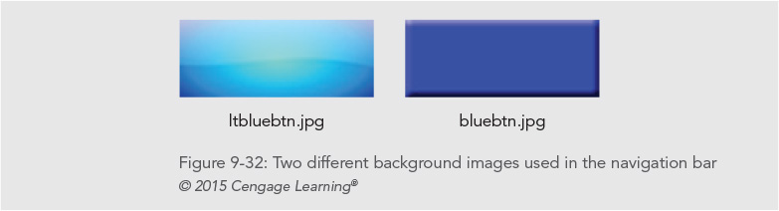

Slide 53
Underlining on Hover
You can use the hover pseudo-class to turn underlining on when the user points to a link
a:hover {text-decoration: underline;}

Slide 54
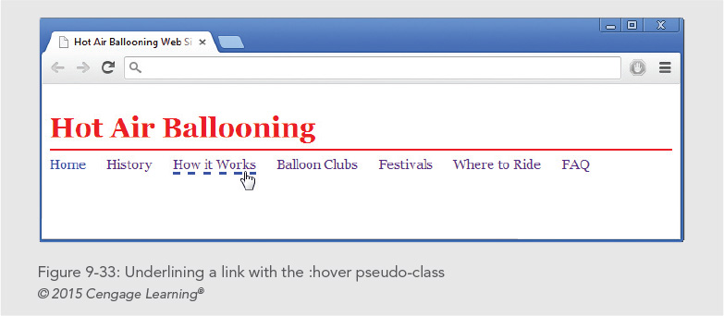

Slide 55
Summary
Usable navigation is the result of working with the power of hypertext and designing for your users’ needs
Work from the user’s point of view
Make all areas of your web site quickly accessible
Provide plenty of location cues
Use text-based navigation bars
Use CSS to build attractive horizontal and vertical navigation bars using simple lists

Slide 56
Summary
Use background colors, text colors, and graphics to enhance navigation
Use the :hover pseudo-class to add interactivity

